Slide 1

Netflix User Data

Slide 2

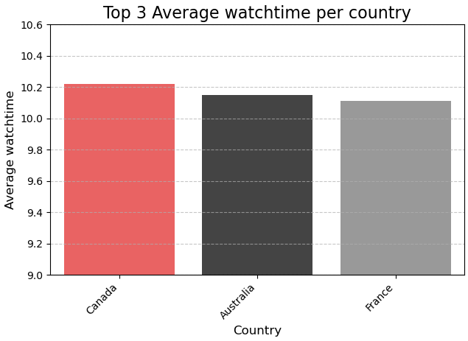
Average watch time per country

Slide 3

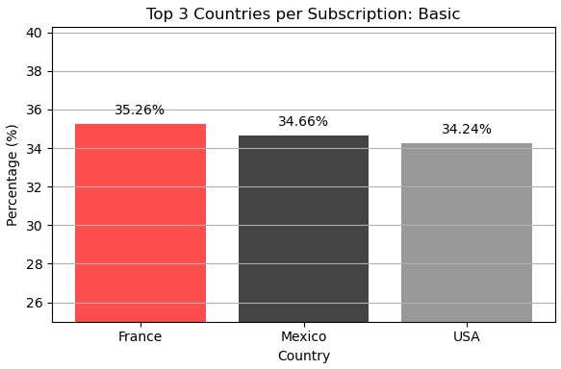
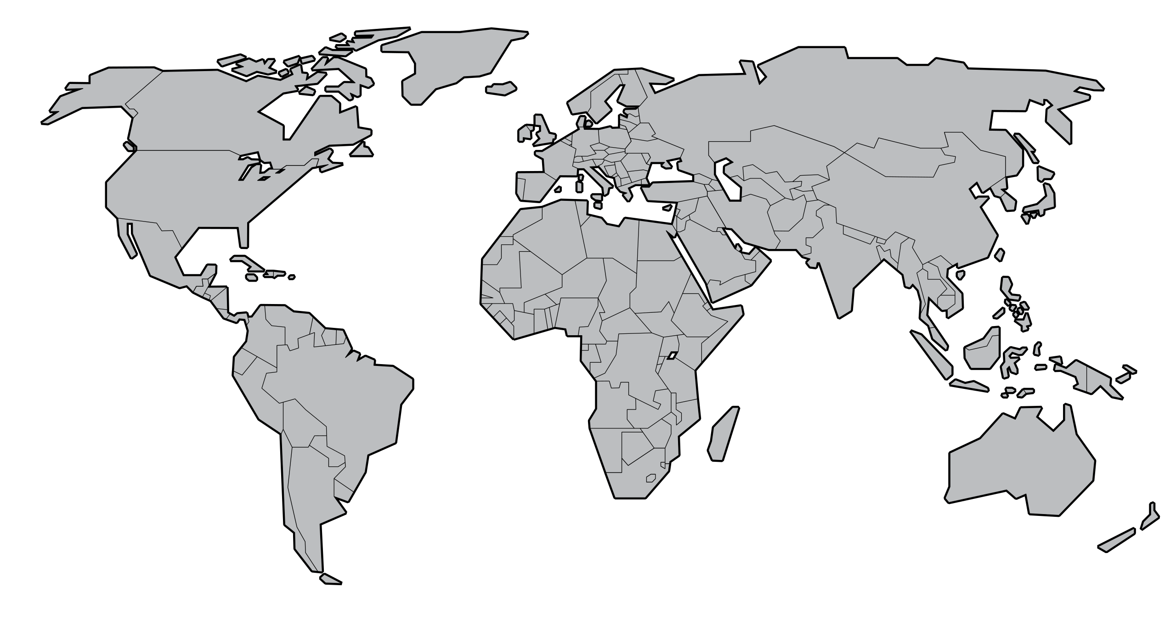
Basic Subscription

Slide 4
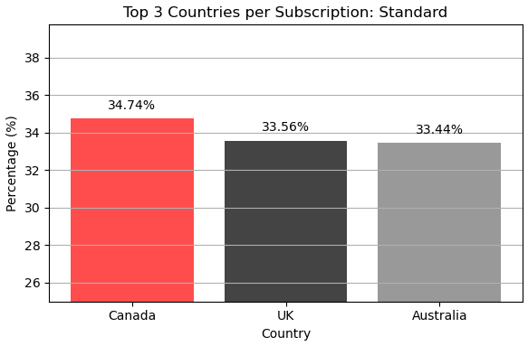
Standard Subscription

Slide 5
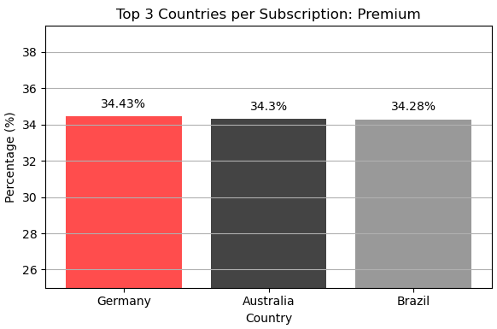
Premium Subscription

Slide 6
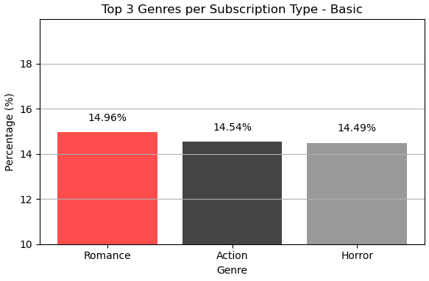
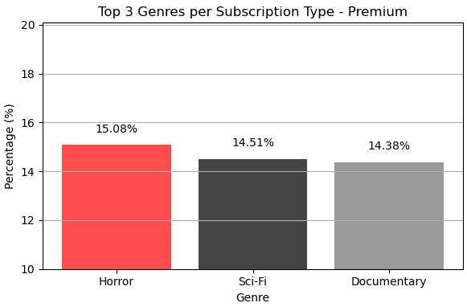

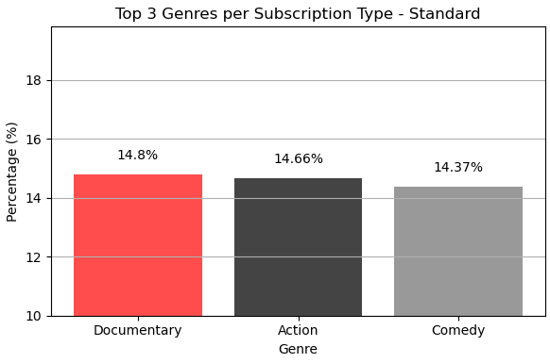
Genres per Subscription

Slide 7
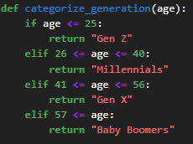

How we Separated the Age Generations

Slide 8
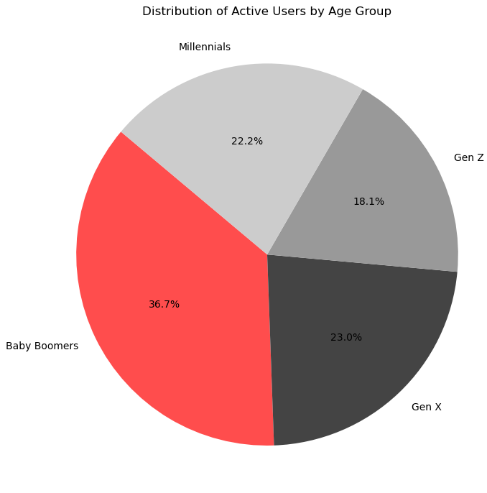
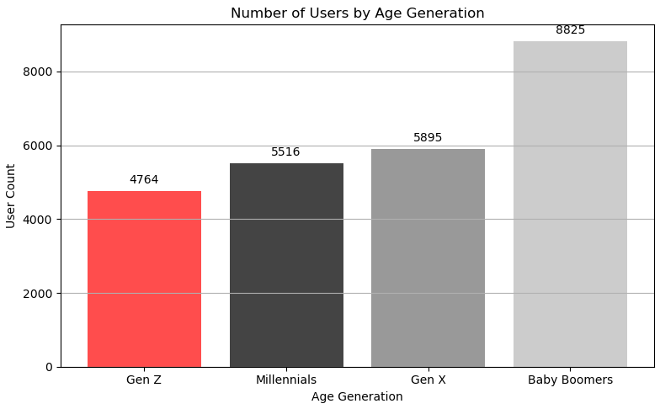

Number of Users per Generation

Slide 9
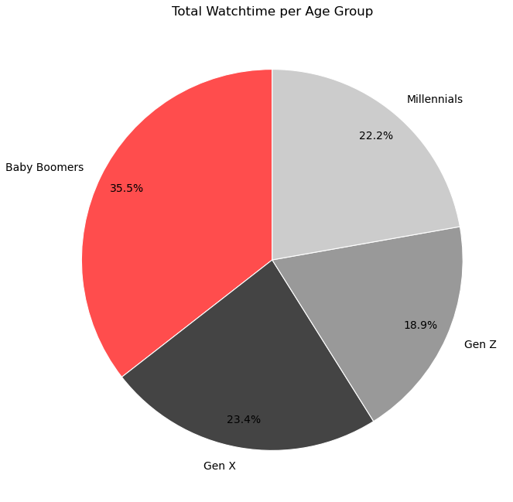
Watch-time per Generation

Slide 10
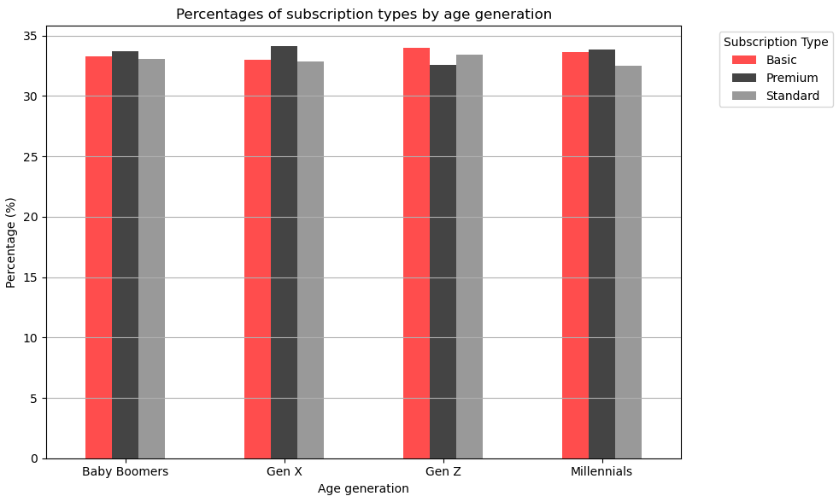
N
Subscription per Generation
HD
FHD
HD
HD
HD
FHD
4K
FHD
4K
4K
4K
FHD

Slide 11
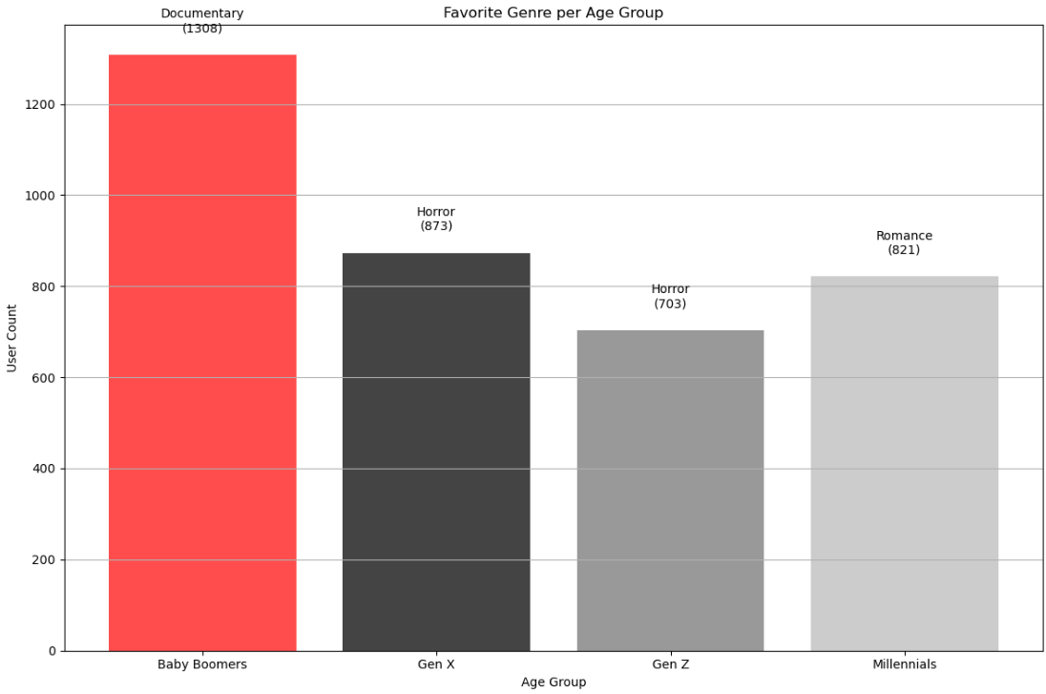
Favourite Genre of every generation
🎥
🎃
💑
🎃

Slide 12
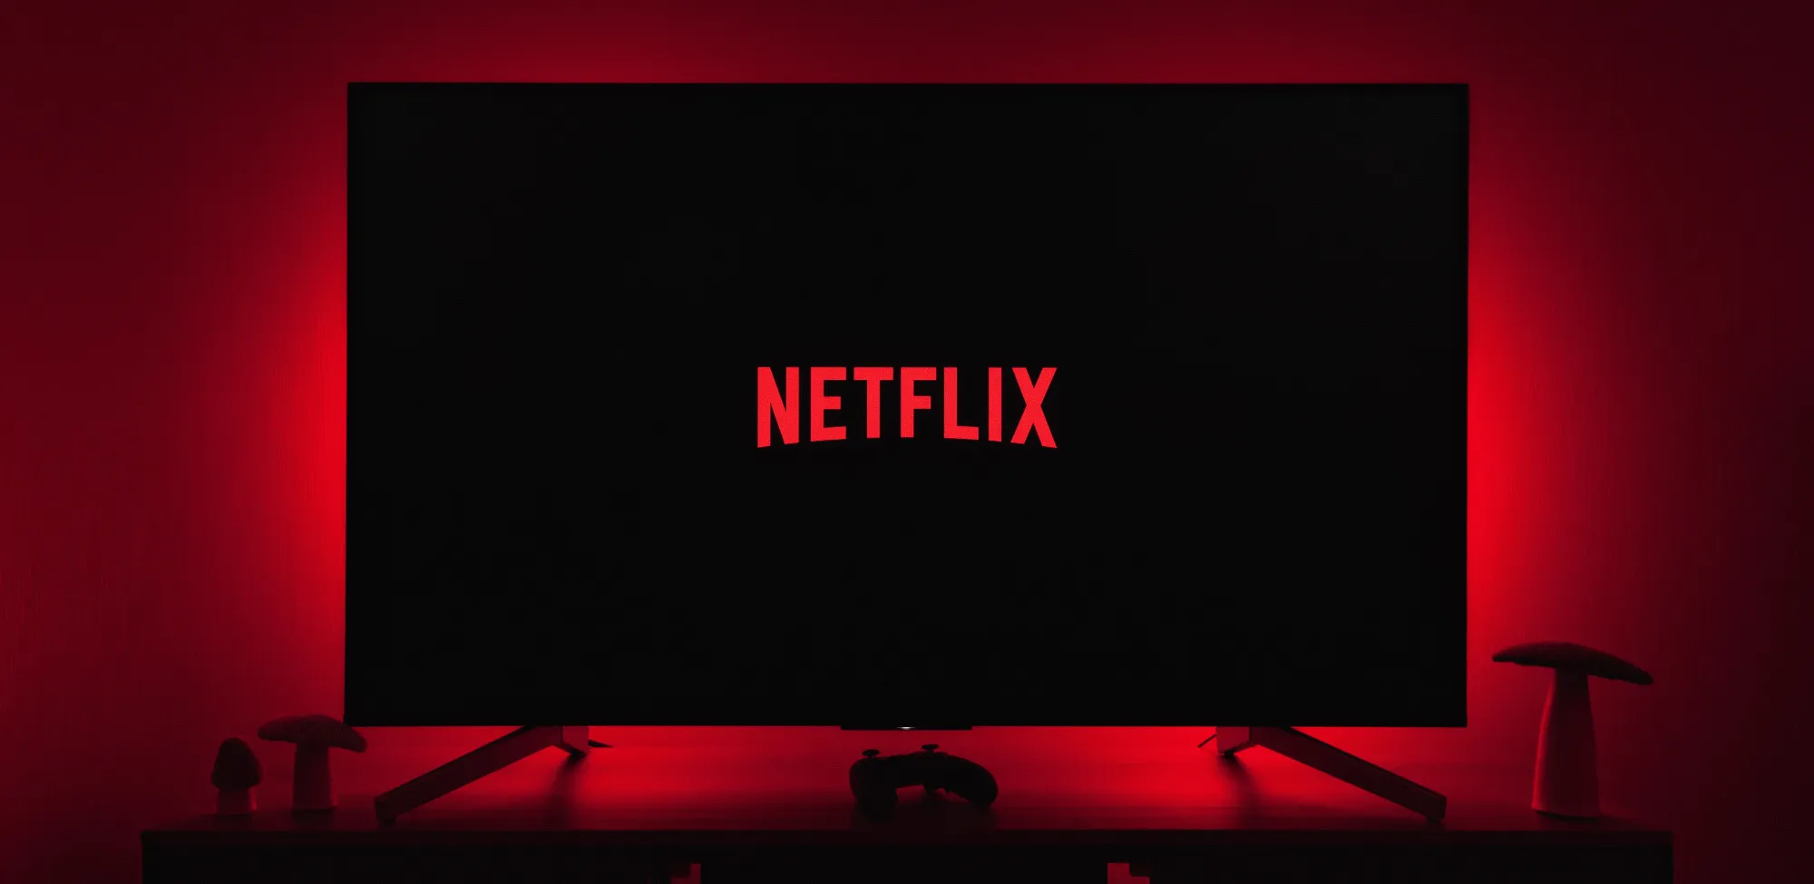
Thank you for your time
Nikos Maraletos
Emmanouil Papachrisanthou
Dimitris Papachrisanthou

